Slide 2
Case study-11.01.2022 Dr. Norbert Ketskés

Slide 3
PROPRIETARY BLENDS LEGEND
PROPRIETARY BLENDS
Proprietary blend I : silica, vitamin c, and trace minerals.
Proprietary blend II : N-acetyl L-tyrosine, anhydrous caffeine, L-theanine, velvet bean seed, pine bark, curcumin, and vitamin D
Proprietary blend III : black seed oil, resveratrol, turmeric, raspberry ketone, apple cider vinegar, aloe Vera, and d-ribose
Proprietary blend IV : Vitamin C, zinc sulfate, and vitamin D3
Proprietary blend V : Inulin, Green Banana flour, apple fiber, bacillus coagulans, spirulina, wheat grass, barley grass, alfalfa leaf, flax seed, psyllium husk powder, chlorella, broccoli, kale, spinach, green cabbage, parsley, aloe vera, cayenne pepper, blueberry powder, pomegranate seed powder, and MCT coconut oil powder
Proprietary blend VI: Vitamin C,D,K2, magnesium oxide, Quercetin, trace minerals, NAD (Béta-Nicotinamide Adenine Dinucleotide)
Proprietary blend VII :Hydrolized Bovine Collagen, Whole Colostrum powder
International Science and Nutrition Society – CURARE CAUSAM – ISNS 2021

Slide 4
Patient: Female
Age: 58 year old
History and test results:
Family history:
No breast cancer occurred
4 months ago, she felt a lump in her right breast, which led to an investigation.
A targeted magnified image and tomosynthesis was performed of the questionable area of ​​the right breast, which shows the signs of high-density malignancy of the shadow seen on the mammographic images.
Breast US: On the right side, a 35x9 mm irregularly shaped, inhomogeneous, hypoechoic mass that is not sharply demarcated from its surroundings is depicted, according to the shadow seen on the mammographic image and the palpation resistance.
Axilla US: Abnormally enlarged lymph nodes in the axillary regions cannot be detected.
Dg.: Tu. mammae l.d.
Core Biopsy: US-guided biopsy sampling was performed from the right-sided lesion under local anesthesia with an automatic pistol with a 14G diameter needle.
Result: B5 Carcinoma lobulare mammae
MRI: On the right side, mainly in the upper quarter, but also affecting the outer quarter, a large, non-circumscribed malignant lesion.
PET CT: Malignancy with high metabolic activity in the right breast, met. cannot be verified.
ISNS CASE STUDY:

Slide 5
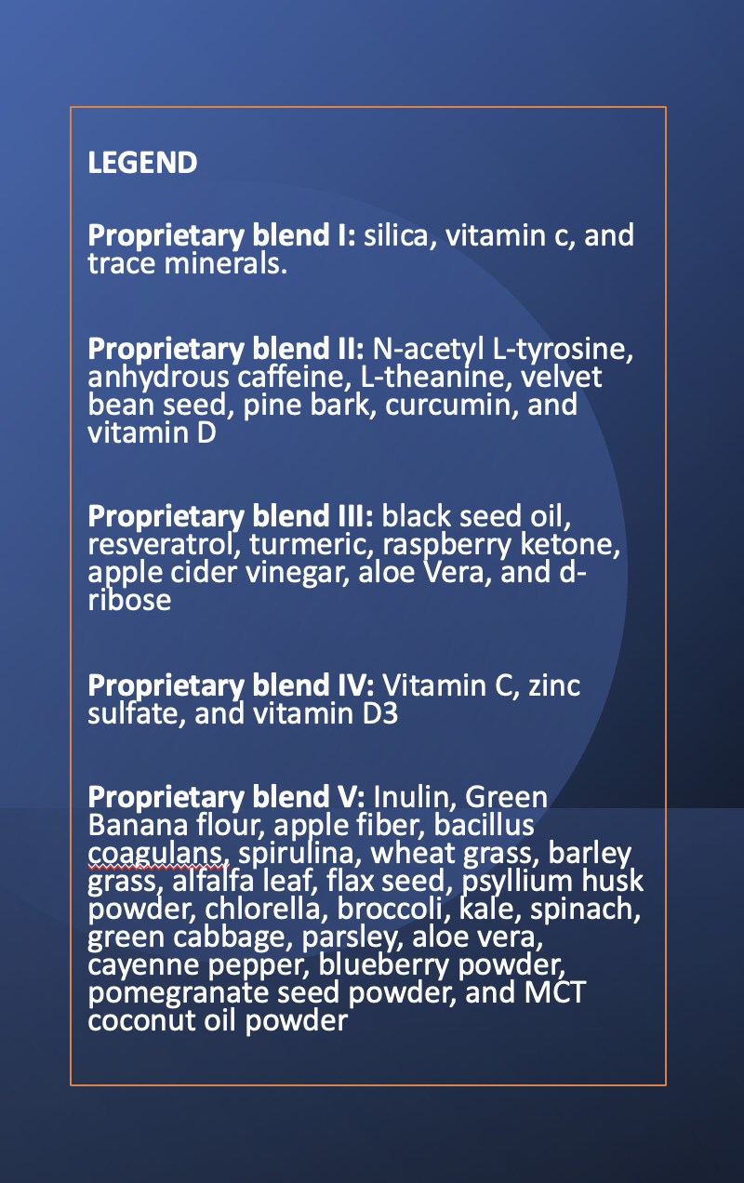
Dosage recommendation
Proprietary blend I : 2x6 drops, morning and evening, for 3 days, then every 3 days then increased by 1-1 drops every 3 days to 2x10
Proprietary blend III :1 sachet in the morning for 3 days,then 1 sachet in the morning and 1 sachet in the evening for 3 days, then 2 sachet in the morning and 1 sachet in the evening
Proprietary blend IV: : ½ teaspoon in the morning for 7 days, then 1 teaspoon in the morning
Proprietary blend V : 1 teaspoon in the evening for 7 days, then 2 teaspoon in the morning and in the evening
Proprietary blend VI: 1 in the morning and 1 in the evening for 7 days, then 2 in the morning and 2 in the evening
International Science and Nutrition Society – CURARE CAUSAM – ISNS 2022

Slide 6
ISNS CASE STUDY
Additional proposal:
A special diet based on my personal experience (more than 10 years)
Exercises to achieve a positive mental and emotional state
International Science and Nutrition Society – CURARE CAUSAM – ISNS 2021

